Slide 1

Basic spoken presentation with the help of AI generative
Mrs. Amelia
EAVIA Library Digital Literacy
8th – 12th grade
1 December 2025 updated 9 December 2025

Slide 2
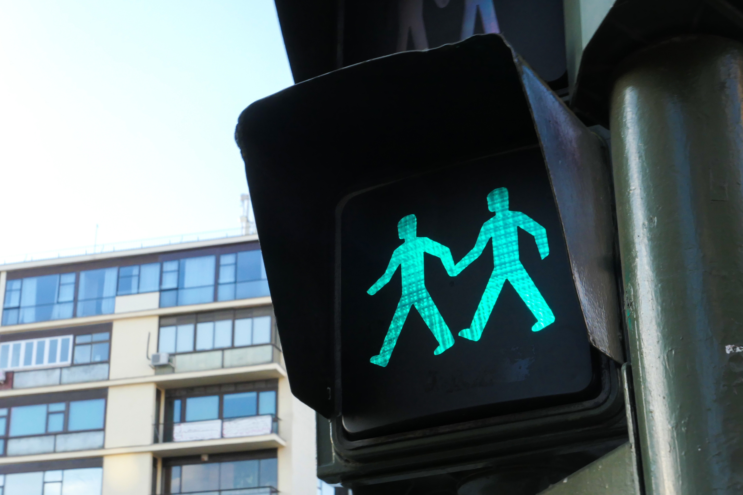
Agenda
Refresh PP suggestions rules
Introduction- AI generative: Perplexity.ai, Gemini, Copilot, ChatGPT 5. Deep Seek.ai?
Engaging the audience
Visual aids
Final tips & takeaways
11 + 12
???

Slide 3

Sabes quién es…
Aravind Srinivas, CEO de Perplexity:
-preocupación sobre el uso de la IA por parte de los estudiantes
-la IA debe ser una herramienta de apoyo para el aprendizaje, no un medio para copiar o evitar el proceso educativo.
-la copia exacta de respuestas generadas por IA va en contra de los principios de aprendizaje y honestidad académica.
-la verdadera utilidad de la IA en la educación está en facilitar la investigación, organizar información y ayudar a los estudiantes a entender mejor los temas.
(CEO de Perplexity pide a los jóvenes que usen menos Instagram y más IA: su futuro puede estar en riesgo – Infobae)

Slide 4
Oral presentations:
Engaging the audience
7 x 7 rule?
Body language, good posture, eye contact,
to involve; tone + volume to emphasize.
Weave relatable stories; memorable and
impactful.
Encourage questions.
Use live polls to gather audience opinions,
making sure the audience feel involved.

Slide 5
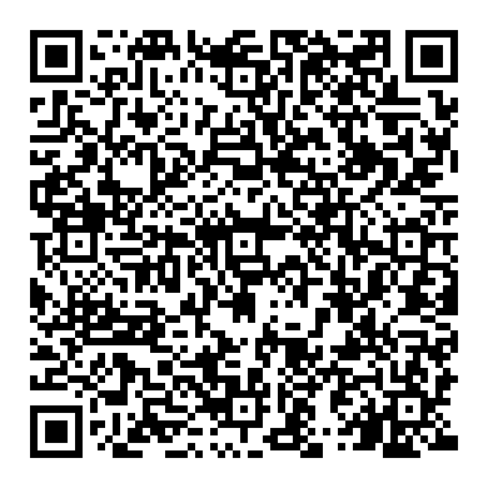
Engaging with QR Code
Survey or poll
“At lunchtime 5th-12th grade students can't use their cellphones in common spaces”
Ask AI to generate the poll questions
In Google Forms make the poll.
Review the results, make adjustments and copy the link
Back to AI and ask the QR Code
Copy to the presentation and engage with it

Slide 6

Confidence-building strategies
Napkin.ai
1. Ask AI your task= prompt.
2. Review the results, make adjustments.
3. Copy to napkin.ai
4. Select to empathize (1 or all)
& your favorite design.
5. Export, download, and share.

Slide 7
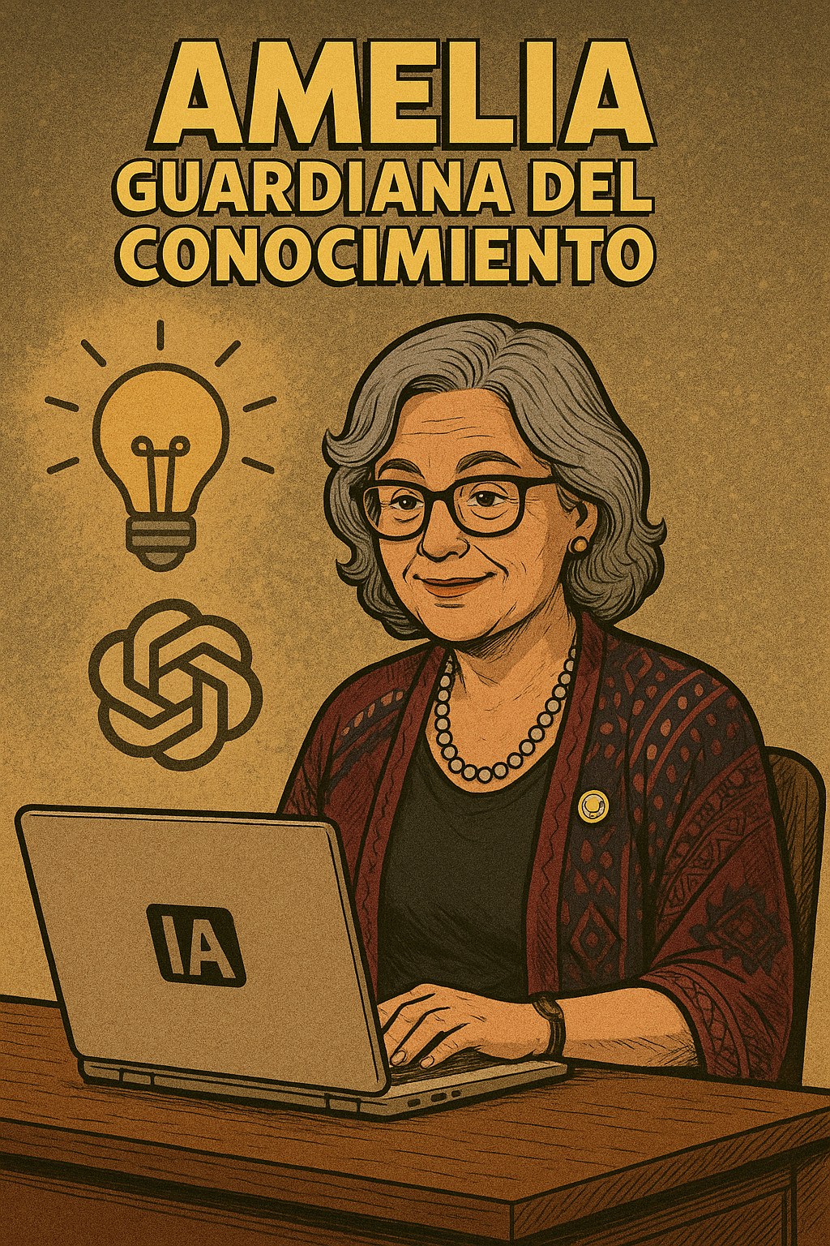
The power of new ideas
I am a librarian and need ideas for lunchroom conversation starters and games, now that 5th-12th grade students can't use their cellphones in common spaces. Create some activities that are age-appropriate and even based on pop culture.

Slide 8
Perplexity generate
Here are several engaging, age-appropriate lunchroom conversation starters and games for 5th-12th graders, especially designed for a no-cellphone environment and inspired by pop culture:
Conversation Starters
"What’s the best fast food restaurant in your opinion? Why?"pittsburghparent
"If you could jump into any book, TV show, or movie, which one would you pick?"extension.msstate
"What’s your favorite snack food and why?"extension.msstate
"What’s the funniest thing you’ve ever seen online or in real life?"extension.msstate
"If you could start a club at school, what would it be about?"prodigygame
Pop Culture-Based Games
Students pair up—one acts as an interviewer and the other as a celebrity (real or fictional). They can use pop culture icons like Marvel heroes, pop stars, or TikTok influencers.bookwidgets
Trivia Challenge: Create pop culture trivia cards (movies, music, sports, memes) and host mini trivia tournaments. Offer small prizes for winners.reddit+1
Would You Rather? Pop Edition: Pose questions like, “Would you rather be a superhero from the MCU or the DC Universe?” or “Would you rather be famous for singing or acting?”prodigygame+1
Unpopular Opinion Showdown: Have students share their unpopular opinions on pop culture topics (e.g., “Ketchup is gross” or “Kittens and puppies are annoying”). This encourages debate and laughter.weareteachers
High/Low Game: Each student shares the best and worst part of their day or week, with a twist: they must connect it to a pop culture reference (song, movie, meme).pittsburghparent
Paper-Based Activities
Offer themed puzzles (music, movies, games) and rotate them weekly.reddit
Coloring Sheets: Provide pop culture-themed coloring pages (e.g., superheroes, anime characters, famous bands).reddit
Storytelling Circle: Students take turns adding to a group story, with each person building on the previous line. Themes can be fantasy, sci-fi, or inspired by trending shows.teachstone

Slide 9
Selecting visual aids

Slide 10
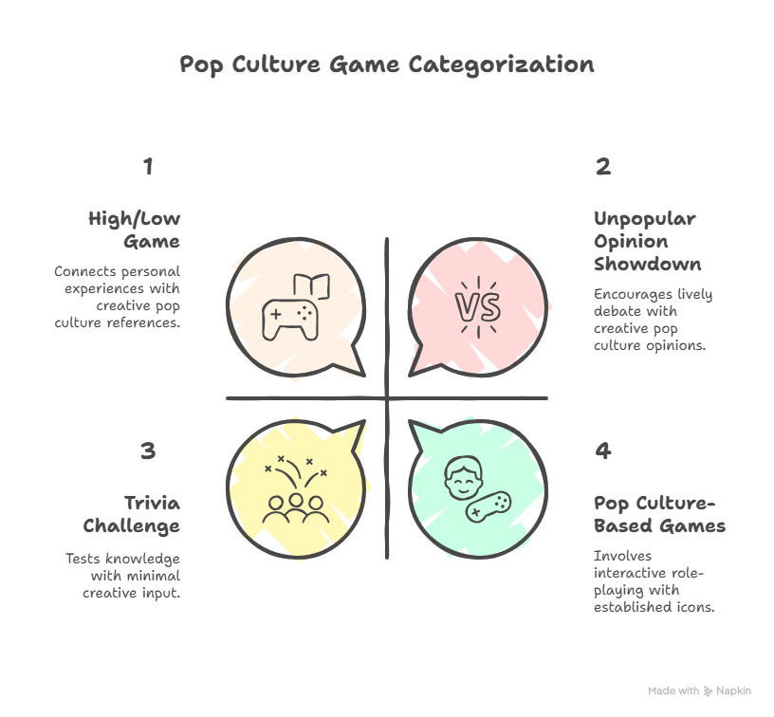
Napkin.ai suggestion

Slide 11
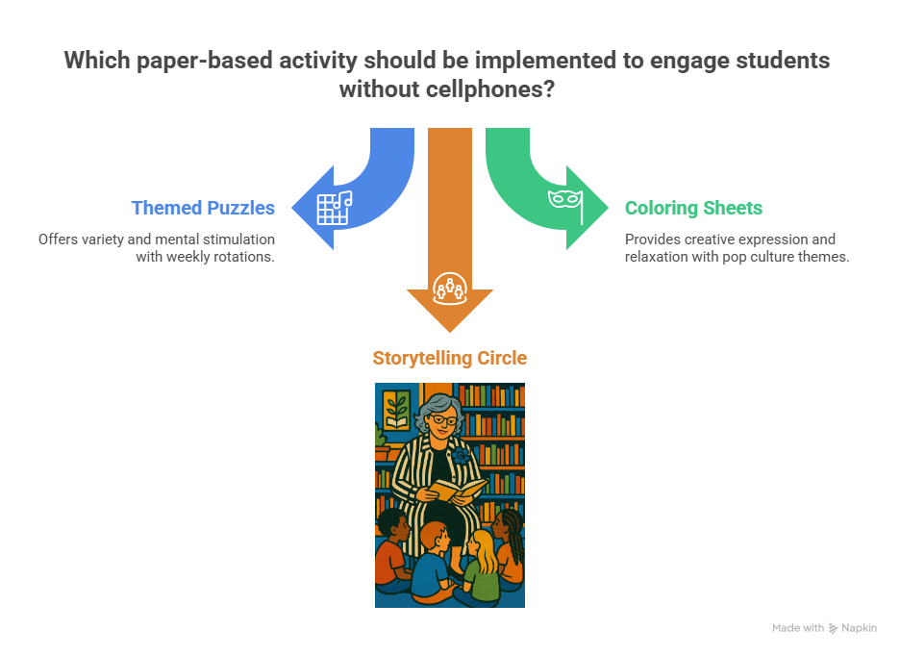
Dynamic delivery + Plans $

Slide 12
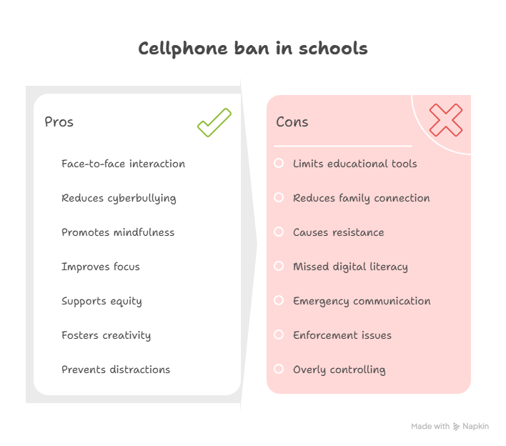

Slide 13
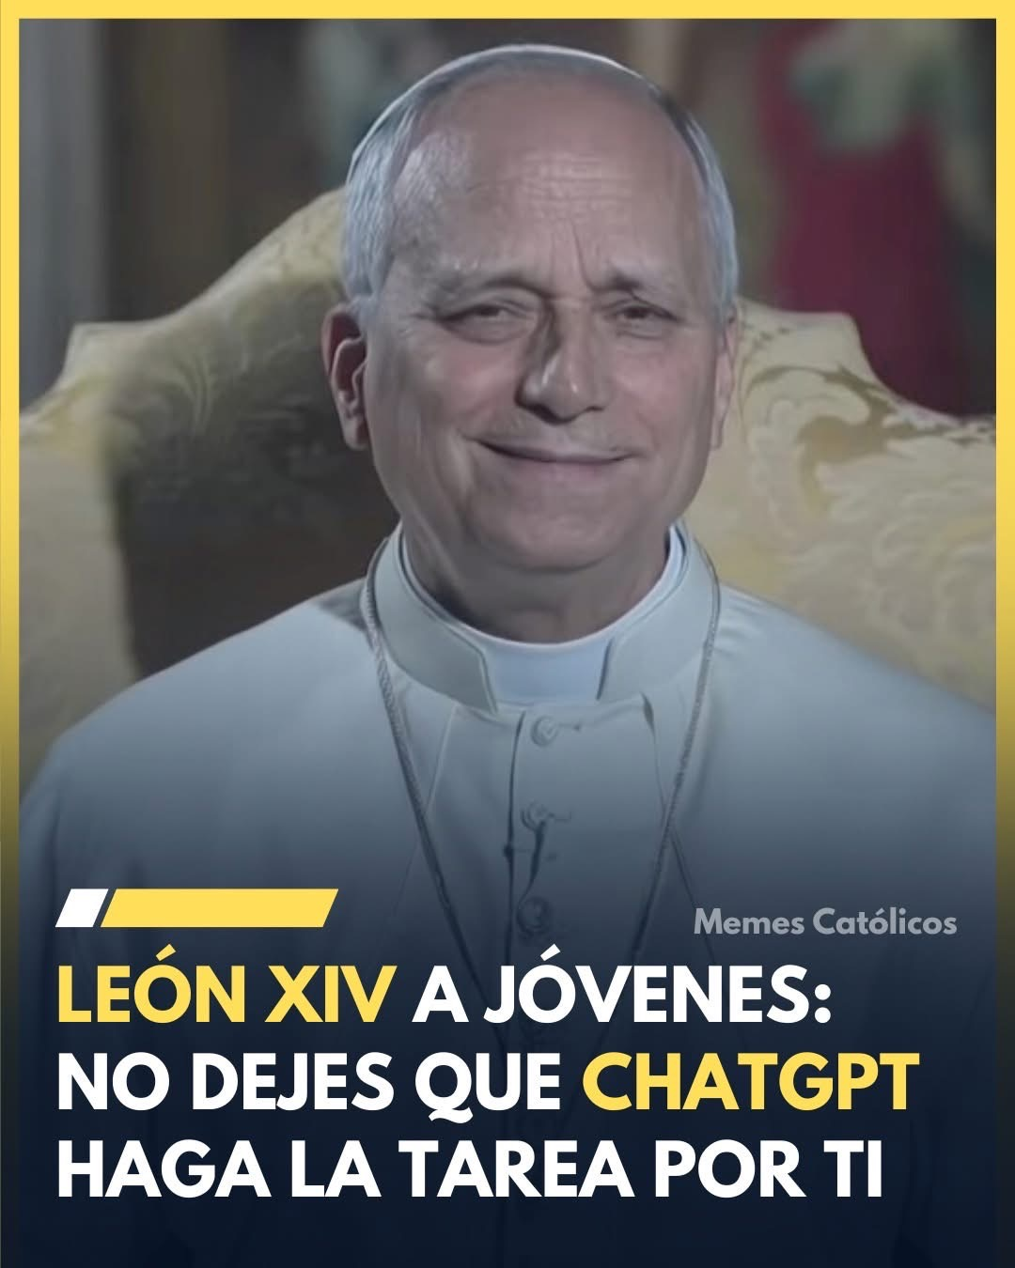
Final tips & takeaways
Set personal goal
Rehearsal your responses.
Actively listen.
Timing and transitions
  Enlist colleagues to listen & provide feedback
  Explore new strategies

Slide 14
Feedback
Thank you,
Mrs. Amelia
caracevedo@aguadilla.inter.edu

Slide 15
Resources
Images:
https://www.facebook.com/santoscatolicoss/photos/-ojo-al-mensaje-del-papa-sobre-la-inteligencia-artificial-el-papa-le%C3%B3n-xiv-nos-h/1485824186876079/
https://www.linkedin.com/in/aravind-srinivas-16051987/
https://app.napkin.ai/page/CgoiCHByb2Qtb25lEiwKBFBhZ2UaJDkyMjdmNTUwLTAzY2ItNGFjMS04MDI2LTM1MzJiMDg3OTdjOA
Text:
https://www.perplexity.ai
https://www.infobae.com/tecno/2025/07/22/ceo-de-perplexity-pide-a-los-jovenes-que-usen-menos-instagram-y-mas-ia-su-futuro-puede-estar-en-riesgo/
https://www.commonsense.org/education/articles/3-core-human-skills-to-build-before-ai-use
https://www.tendenciaseducativas.org
https://leaderbiography.com/aravind-srinivas/

